Slide 1
Introduction to Partial Differential Equations
by
Dr. Md. Rajibul Islam
CSE, UAP
http://numericalmethods.eng.usf.edu

Slide 2
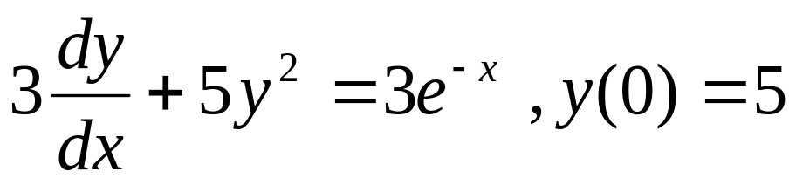
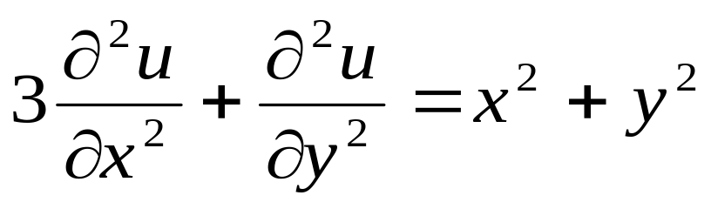
What is a Partial Differential Equation ?
Ordinary Differential Equations have only one independent variable
Partial Differential Equations have more than one independent variable
subject to certain conditions: where u is the dependent variable, and x and y are the independent variables.

Slide 3
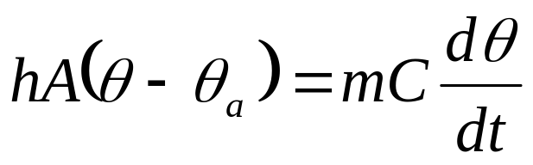
Example of an Ordinary Differential Equation
Assumption: Ball is a lumped system.
Number of Independent variables: One (t)
Spherical Ball
Hot Water

Slide 4
Example of an Partial Differential Equation
Assumption: Ball is not a lumped system.
Number of Independent variables: Four (r,θ,φ,t)
Spherical Ball
Hot Water

Slide 5
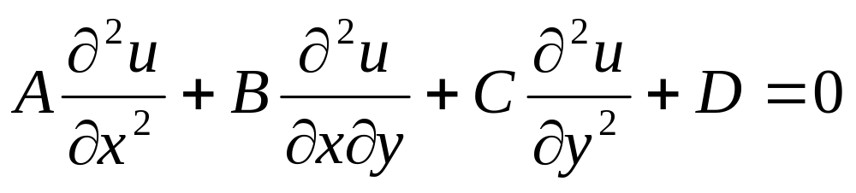
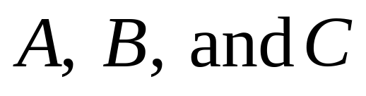
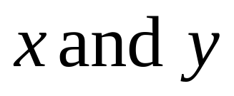
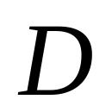
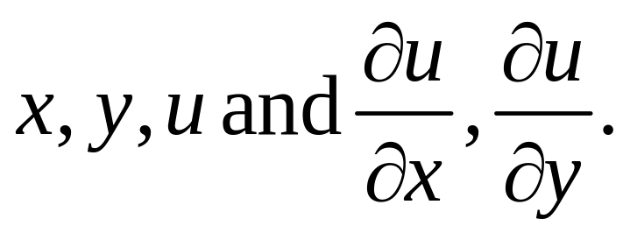
Classification of 2nd Order Linear PDE’s
where are functions of ,and is a function of

Slide 6
Classification of 2nd Order Linear PDE’s
can be:
Elliptic
Parabolic
Hyperbolic

Slide 7
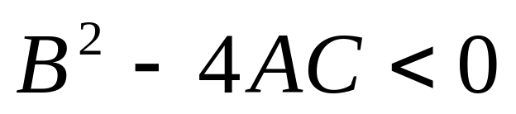
Classification of 2nd Order Linear PDE’s: Elliptic
If ,then equation is elliptic.

Slide 8
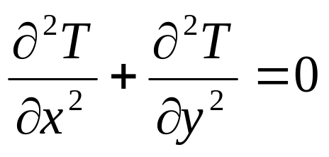
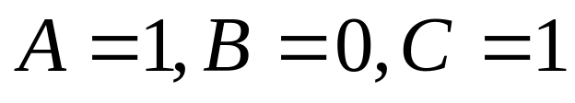
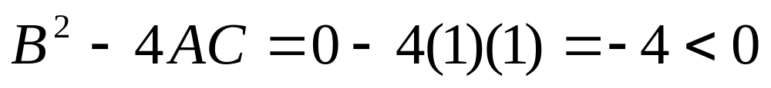
Classification of 2nd Order Linear PDE’s: Elliptic
Example:
where, giving
therefore the equation is elliptic.

Slide 9
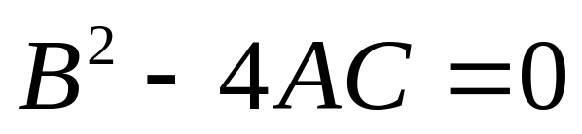
Classification of 2nd Order Linear PDE’s: Parabolic
If ,then the equation is parabolic.

Slide 10
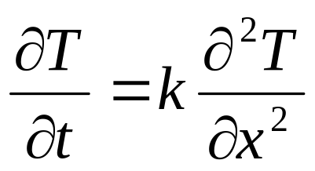
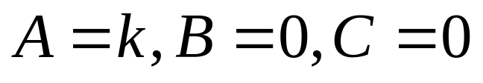
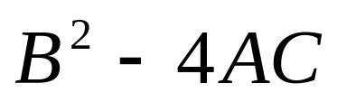
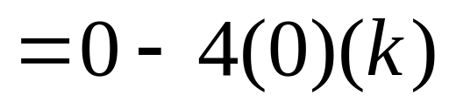

Classification of 2nd Order Linear PDE’s: Parabolic
Example:
where, giving
therefore the equation is parabolic.

Slide 11

Classification of 2nd Order Linear PDE’s: Hyperbolic
If ,then the equation is hyperbolic.

Slide 12
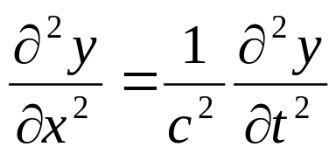
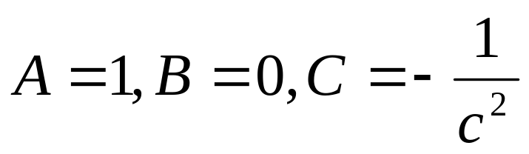
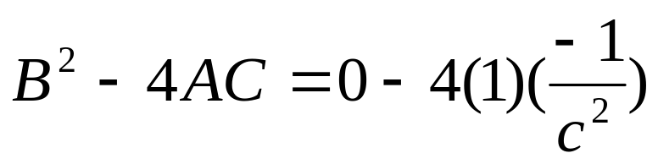
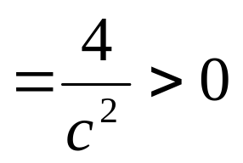
Classification of 2nd Order Linear PDE’s: Hyperbolic
Example:
where, giving
therefore the equation is hyperbolic.

Slide 13
THE END

